Slide 1

Improvement of Optical Confinement for the Perovskite Solar Cell
Presented By
Supervised By
Ajmal Ahmed
1802098
Dr. Mahmud Abdul Matin Bhuiyan
Professor,
Dept. of EEE, CUET.
Mohammad Iftekher Ebne Jalal
1802119
Department of Electrical and Electronic Engineering
Chittagong University of Engineering and Technology
Notes:
Assalamualaikum Everyone. This is Iftekher, along with Ajmal Ahmed, on this very podium, presenting the proposal of our Thesis as a part of our academic coursework. As you can see the title on the screen, we will be venturing into improving the containment of light within the solar cells hence titled it as the Improvement of Optical Confinement for the Perovskite Solar Cell.

Slide 2

Presentation Outline
Background & Motivation
Objectives
Literature Review
Research Gap
Methodology
Design a Reference Cell
Parameter Considerations
Simulation
Result Analysis and Review
Progress and Timeline
References
Notes:
Here’s the order of our discussion.
Now, before we begin – I will be sharing very well known aspects, just to set the tone.

Slide 3
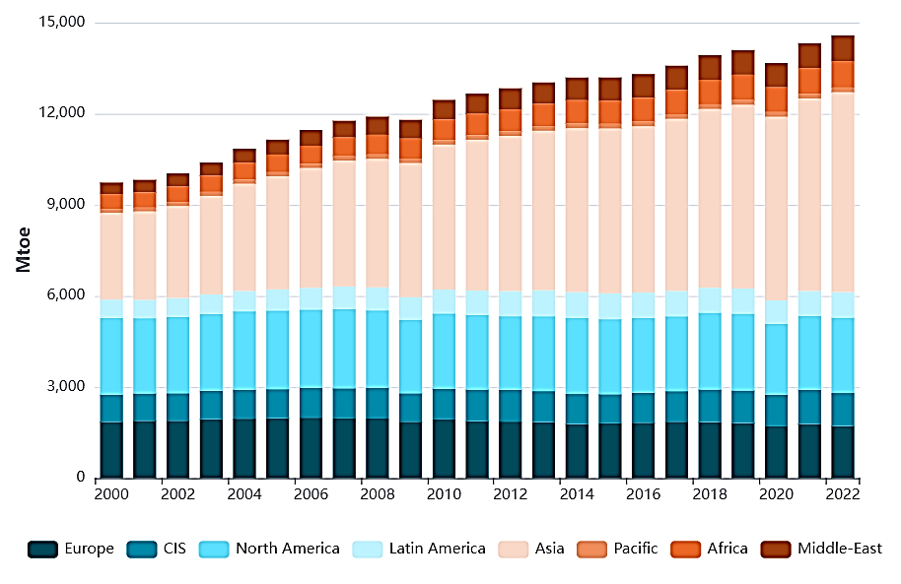
Background
Credit : World Energy Statistics | Enerdata
Notes:
1st – energy demand has increased well around 70% within past 22 years, going from 9000 to shooting upto 15000Million Tonnes of oil equivalent.

Slide 4

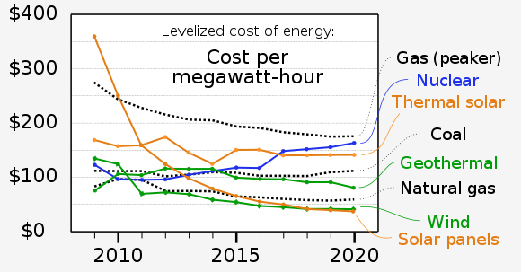
Background
Credit : World Energy Statistics | Enerdata
Credit: Wikimedia Commons
Notes:
But, at the same time, we have seen solar pv cost reducing more than 80% within just last 10 years.

Slide 5
Background
Among all the renewable sources, Solar photovoltaic (PV) technology, in particular, has seen a remarkable 82% cost reduction from 2010 to 2019, according to the International Renewable Energy Agency (IRENA) [1].

Slide 6
Background
Among all the renewable sources, Solar photovoltaic (PV) technology, in particular, has seen a remarkable 82% cost reduction from 2010 to 2019, according to the International Renewable Energy Agency (IRENA) [1].
Different types of Solar Cells
Crystalline Silicon (c-Si) Cells | Multijunction Cells
Thin-Film Solar cell | Tandem Cells
Organic Cell | Quantum Dot Solar Cells
Perovskite Solar Cell | Organic-Inorganic Hybrid Solar Cells
Dye-Sensitized Solar Cells (DSSC)
With the progression of research, we have seen different types of solar cells emerging.
Notes:
This progression led to designing newer and emerging cells, listed on the screen and Perovskite stands out. Even though problems like stability, durability and Led toxicity exists, we prefer this for
Rapid Efficiency Improvement (3% in 2009 , above 26% 2023)
Easy Fabrication (Spin coating method)
Low temperature processing (even at 25 degree Celsius)
Now, you may think – why did we chose to go with optical confinement ?

Slide 7
Background
If light is not confined well within a solar cell, it can experience multiple outcomes :
Reflection
Some of the light may be reflected off the surface of the cell and eventually fail to interact with the active materials of the cell itself.
Notes:
Light associated losses can become extremely critical with issues such as
1. Reflection

Slide 8
Background
If light is not confined well within a solar cell, it can experience multiple outcomes :
Reflection
Absorption in Non-Active Layers
Not all the incident light is absorbed in the active material of the solar cell.
Notes:
2. Absorption in Non-Active Layers such as (i) Substrate (ii) Encapsulation Layer (iii) Other intermediate Layer

Slide 9
Background
If light is not confined well within a solar cell, it can experience multiple outcomes :
Reflection
Absorption in Non-Active Layers
Transmission
Some of light might pass through the cell entirely without being absorbed, resulting in a loss of energy.
Notes:
3. Transmission – if the photon profile doesn’t match with the absorber material’s optical profile.

Slide 10
Background
If light is not confined well within a solar cell, it can experience multiple outcomes :
Reflection
Absorption in Non-Active Layers
Transmission
Photons with energy lower than the material's band gap cannot be absorbed, so their energy is lost as they pass through the cell.
Photon Energy Below Band Gap
Notes:
Photon Energy Below Band Gap of the absorber material itself

Slide 11
Background
If light is not confined well within a solar cell, it can experience multiple outcomes :
Reflection
Absorption in Non-Active Layers
Transmission
Photon Energy Below Band Gap
Inefficient light confinement can lead to reduced photon absorption and lower overall conversion efficiency, limiting the cell's ability to harness sunlight and convert it into usable electrical power.
Notes:
And more loss are accounted !

Slide 12



Objectives
Examine the optical confinement techniques for Perovskite Solar Cell.
Compare among the confinement methods that have already been studied in other research works.
Propose a confinement method for improved Power Conversion Efficiency (PCE).
Notes:
So, we look forward to studying the optical confinement methods > compare them > finally propose techniques in a way that can be used in different classes of solar cells for increased efficiency.

Slide 13
Literature Review
Cell worked on
Confinement Methods Used
Examined Samples
Outcomes
Notes:
Going through the literature, we looked at 4 key aspects which are (i) Cell (ii) Confinement Technique (iii) Examined Samples (iv) Outcomes

Slide 14
Literature Review
Ref. | Cell | Confinement Methods | Examined Samples | Outcome
 |  |  |  | Jsc* | Efficiency
[2] | ZnO:Al/ZnO/CdS/ CIGS/interfacial layer/Mo/glass | Anti-reflection at front Interfaces (Air/Glass). | Thick Layer | + 4.4%
 |  |  | Thin Layer | + 4.4%
 |  | Highly reflective back contact (ZrN). | Thick Layer | + 1.6%
 |  |  | Thin Layer | + 8.1%
 |  | Light scattering between absorber and back contact. | Thick Layer | + 1.7%
 |  |  | Thin Layer | + 17.8%
 |  | Light Management by semi-ellipsoidal texture. | Thin Layer | + 22%
[3] | ITO/PEDOT:PSS/ CH₃NH₃PbI₃−xClx/ PCBM/Bphen/Ag | Incorporated moth-eye nanostructures in metal back electrode via soft nano imprint lithography | Flat | 19.16 | 14.2%
 |  |  | Grating | 20.76 | 15.4%
 |  |  | Moth-eye | 21.9 | 16.3%
[4] | ITO/p-a SiC:H/i-a Si:H/ n-a Si:H/ AZO/Ag NPs/AZO/ Ag/glass/ | Plasmonic BR with random arrays of Ag NPs | Flat n-i-p | 13.1 | 6.3%
 |  |  | Plasmonic n-i-p | 15.1 | 7.9%
 |  |  | Textured n-i-p | 14.8 | 7.8%
 |  |  | Textured p-i-n | 17.4 | 11.1%
Notes:
Starting with the reference 2, this isn’t actually a perovskite solar cell, rather CIGS based one where thickness had been varied and Light Management by semi-ellipsoidal texture championed with the highest short circuit current density increase.
But it’s the Ref 3, where moth-eye nanostructures reached around 16% efficiency.
But Ref 4, an early work published waaay back in the year 2012, shared that Plasmonic back reflector, even though was assumed to perform well, came short with 7.9% of efficiency.

Slide 15
Literature Review
Ref. | Cell | Confinement Methods | Examined Samples | Outcome
 |  |  |  | Jsc* | Efficiency
[5] | ITO/TiO2/Perovskite/ CuSCN/Back Contact | Nanostructured PSC with plasmonic enhancement in modified structure | Planar cell | 18.54 | 15.1%
 |  |  | Modified Cell (with varied curvature) | 23.4 | 21%
[6] | ITO/TiO2/ CH₃NH₃PbI₃:P3HT:Al | Atop antireflection electrode based on dielectric fiber arrays | Plain and Fiber arrayed top layer (varied fiber radius, spacing and angular incidence) | + 6.3%
[7] | ITO/PEDOT:PSS/ Perovskite/ ZnO/ Ag | Spheroid Ag nanoparticle (np) at back | Without np | 18.57 | 16.66%
 |  |  | Spheroid np (e=0) | 21.36 | 18.21%
 |  |  | Spheroid np (e=.75) | 22.94 | 21.58%
 |  |  | Spheroid np (e=.89) | 23.88 | 22.92%
 |  |  | Spheroid np (e=.92) | 16.15 | 13.26%
[8] | ITO/TiO₂/MASnI₃/Spiro-OmeTAD/Au | Incorporation of ZrN/SiO2 shell nanoparticles in the active layer. | Planar | 27 | 12.9%
 |  |  | ZrN/SiO2 (90nm) | 34.5 | 16.9%
 |  |  | ZrN/SiO2 (115nm) | 40.3 | 20%
Notes:
Interestingly, here in the Ref 5, a very recent work published in 2023, that same plasmonic effect caused massive rise when the structure itself was modified. Later we studied structures like dielectric fiber array. But another recent work with Silver nanoparticle at back, we found spheroid silver nanoparticle in a particular eccentricity outperforming other variants, efficiency shooting around 23%
Also, Zirconium Nitride-Silicon Di Oxide shell NPs exhibited 20% efficiency.

Slide 16
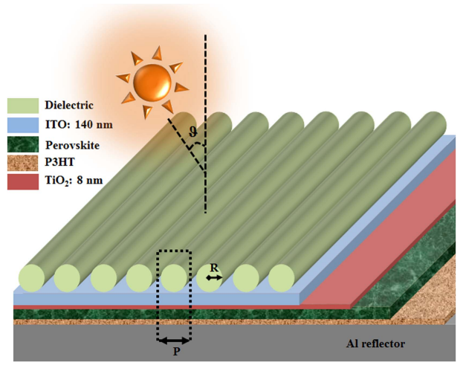
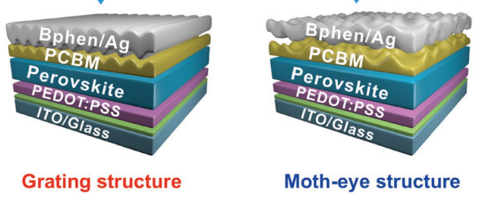
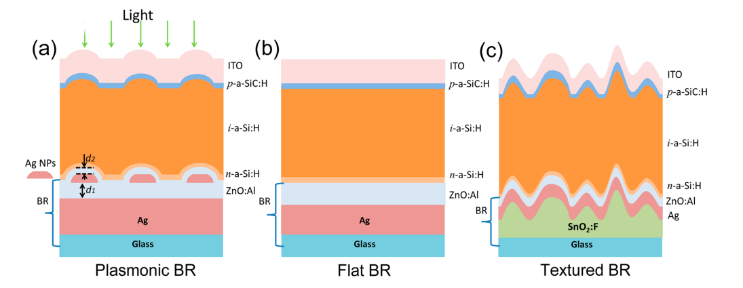
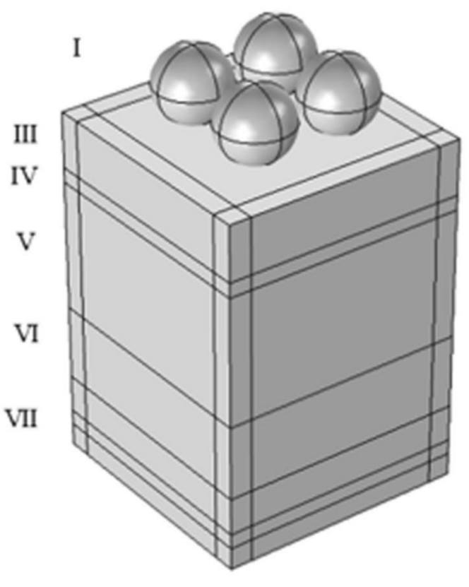
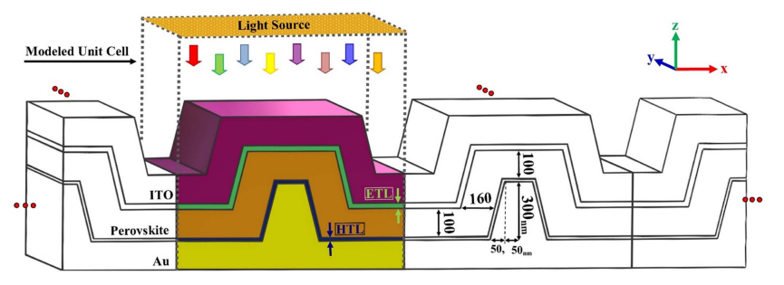

[3]
[6]
[4]
[8]
[5]
Notes:
These are some of those models we covered in the review where you can find the moth-eyed structure, plasmonic back reflectors , the modified cell structure. On the left, the dielectric fiber array and also the Zirconium Nitride-Silicon Di Oxide shell NPs

Slide 17
Literature Review
Table : Different types of optical confinement techniques
Table : Considerable Parameters
Category | Techniques
Front Surface | Moth Eye Texture
 | Top Antireflection Front Electrode (p-ARFE)
Back Surface | Highly Reflective Back Contact
 | Plasmonic Scattering
Intermediate Layer | Light Scattering Layers
 | Aperiodic Arrays
 | Microlens Arrays
 | Optical Cavities
Material and Absorption Enhancement | Spherical Structures
 | Nanoparticle Integration
 | Tuning Perovskite Absorbent
 | Device Architectural Manipulation
Optical | Electrical
Reflection coefficient | Short Circuited Current density (Jsc)
Refraction coefficient | Fill Factor (FF)
Absorption | Power Conversion Efficiency (PCE)
Haze
Scattering
Optical Path
Notes:
So, along with identifying the parameters we need to look at, we have primarily found 12 commonly used techniques here and clustered them into 4 categories. But please note that, these techniques have been tested for different cells, so we really don’t know if they can have a generalized use case.

Slide 18
Research Gap
As of this date, according to our literature review,
We do NOT have any generalized or semi generalized optical confinement method for the solar cells, especially for the Perovskite Solar Cells.
Notes:
So, having no one-size fits all solution or at least the lack of any semi generalized technique appear as a major gap. To address this, how we are going forward ? Let’s hear it from Ajmal.

Slide 19
Methodology
Design a reference cell
Parameter Considerations
Simulation
Review and Result Analysis
General Flow
Notes:
In order to look forward a generalized techniques, initially our goal is to-
Reduce optical losses and
Feed more light in the absorber layer as we know absorption of more light in absorber layer produces more electron hole pair thus more photocurrent.

Slide 20
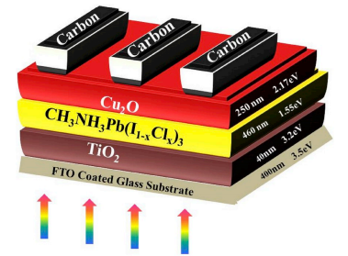
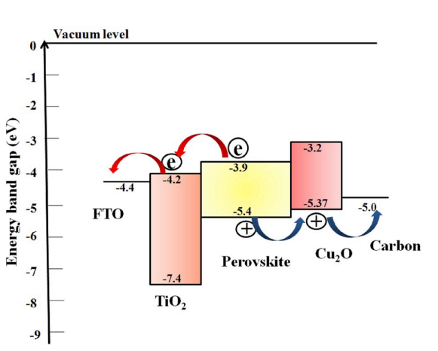
Methodology
Design a reference cell
Parameter Considerations
Simulation
Review and Result Analysis
General Flow
Figure: Selected Solar Cell [9]
(Glass/FTO/TiO2/CH3NH3Pb(I1-xClx)3/Cu2O/Carbon)
Figure: Band Alignment [9]
Notes:
First of all we have to choose a reference cell where we will apply the optical confinement technique in order to improve eff.
Mixed halide perovskite was chosen for its improved stability, band gap tunability.
The cell contains Methylammonium lead iodide-chloride as absorber layer, Tio2 as ETL, Cu2O as HTL, FTO and Carbon as front and back contact. Band alignment is shown in the figure.

Slide 21
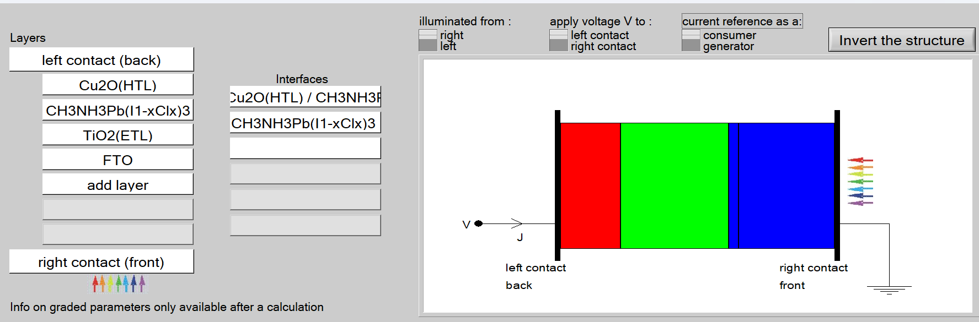
Methodology
Design a reference cell
Parameter Considerations
Simulation
Review and Result Analysis
General Flow
Figure: Simulation of SCAPS 1D
Notes:
We have simulated the our reference cell in the scaps 1D using the Data collected from the reference paper.
Here is the set up of layer in Scaps program.

Slide 22
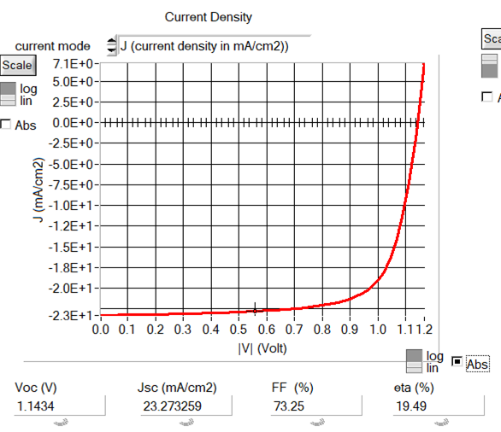
Methodology
Design a reference cell
Parameter Considerations
Simulation
Review and Result Analysis
General Flow
Parameters | From Literature [9] | From Experiment | From Simulation
Voc (V) | 1.15 | 1.11 | 1.14
Jsc (mA/cm²) | 23.34 | 22.3 | 23.27
FF (%) | 70.31 | 74.5 | 73.25
PCE (%) | 18.92 | 18.4 | 19.49
Figure: Simulation Result & Comparison with the Literature
Notes:
Using the data obtained from our reference cell, we have found the efficiency around 19.49%
which is very closed to our literature and experimental value.
we plan to work on few other variants of perovskite solar in order to test our general case applicability.

Slide 23
Methodology
Design a reference cell
Parameter Considerations
Simulation
Review and Result Analysis
General Flow
Optical | Electrical
Reflection coefficient | Short Circuited Current density (Jsc)
Refraction coefficient | Fill Factor (FF)
Absorption | Power Conversion Efficiency (PCE)
Haze
Scattering
Optical Path
Notes:
We have to deal with various optical and electrical parameter
like R_P,R_P, A_P, scattering as optical perameter and
obviously Jsc, EFF are electrical parameter

Slide 24
Methodology
Design a reference cell
Parameter Considerations
Simulation
Review and Result Analysis
General Flow
Ansys Lumerical
Method I
Anti Reflection Coating Material
Silver Nanoparticle at Back
Dielectric Fiber Array at Top
Select ARC Material with Proper Refractive Index
Apply in the Top Portion
Optimize Thickness
Investigate Transmission, Absorption & Reflection Profiles
Investigate Jsc & PCE improvement
Notes:
Initially we are planned to work on three different optical confinement method. We will simulate each of this in ANSYS Lumerical
First, we will apply anti reflection coating, so that reflection of the light from the solar cell can be minimized.
So more light can enter in absorber layer.
Anti reflection layer mainly made of dielectric which is applied on the top of the solar cell.
Optimizing the thickness of the anti-reflection layer we will investigate for the best solution.

Slide 25
Methodology
Design a reference cell
Parameter Considerations
Simulation
Review and Result Analysis
General Flow
Ansys Lumerical
Method II
Anti Reflection Coating Material
Silver Nanoparticle at Back
Dielectric Fiber Array at Top
Design Ag nanoparticle components
Optimize eccentricity
Investigate Scattering, Absorption and Reflection
Investigate Jsc and PCE improvement
Apply in the back layer
Notes:
In the second method, we will Use silver nanoparticles at the back of a solar cell.
These nanoparticles have plasmonic properties that scatter and trap light within the cell, which increases the chances of more light absorption.
Optimizing the eccentricity and other perameter of the nanosphere we will seek for the best optical and electrical profiles.

Slide 26
Methodology
Design a reference cell
Parameter Considerations
Simulation
Review and Result Analysis
General Flow
Ansys Lumerical
Method III
Anti Reflection Coating Material
Silver Nanoparticle at Back
Dielectric Fiber Array at Top
Design atop antireflection electrode based on dielectric fiber arrays
Optimize fiber radius & spacing
Investigate Transmission Absorption and Reflection Profiles
Investigate Jsc and PCE improvement
Apply in front layer
Notes:
In the next method we will use dielectric fiber array on top of a surface.
These arrays can manipulate the path of light, which increases light interaction with the absorption layer.
We will optimize the fiber radius and spacing to come up with the best result.

Slide 27

Methodology
Design a reference cell
Parameter Considerations
Simulation
Review and Result Analysis
General Flow
Detailed analysis and provide recommendation on the selection of optical confinement methods for upcoming research works.
Increased Jsc and Efficiency for Perovskite Solar cell.
Develop generalized or semi-generalized methods for different clusters of cell structure for optical confinement.
Notes:
Our goal is to-
Provide optical confinement techniques for the perovskite solar cell to improve the Jsc as well as efficiency.
Most importantly we will try to develop generalized or semi-generalized technique for light confinement.

Slide 28
Progress & Timeline
Notes:
We have structured our entire project into five key components.
Significant progress has been achieved in three of these critical segments: Preliminary Investigation & Planning (PIP), Literature Review (L.R), and Methodology development.
The remaining phases, Simulation and Conclusion, will be finalized by the end of the fourth year.
Till now we are learning LUMERICAL for our simulation.

Slide 29
References
[1] IRENA, “Renewable Power Generation Costs in 2019,” Abu Dhabi, 2020.
[2] J. Krc, M. Sever, A. Campa, Z. Lokar, B. Lipovsek, and M. Topic, “Optical confinement in chalcopyrite based solar cells,” Thin Solid Films, vol. 633, pp. 193–201, Jul. 2017, doi: 10.1016/j.tsf.2016.08.056.
[3] J. Wei et al., “Enhanced Light Harvesting in Perovskite Solar Cells by a Bioinspired Nanostructured Back Electrode,” Adv Energy Mater, vol. 7, no. 20, Oct. 2017, doi: 10.1002/aenm.201700492.
[4] H. Tan, R. Santbergen, A. H. M. Smets, and M. Zeman, “Plasmonic light trapping in thin-film silicon solar cells with improved self-assembled silver nanoparticles,” Nano Lett, vol. 12, no. 8, pp. 4070–4076, Aug. 2012, doi: 10.1021/NL301521Z/SUPPL_FILE/NL301521Z_SI_001.PDF.
[5] A. Tooghi and Y. Karimi Yonjali, “A modified architecture of a perovskite solar cell with an enhanced optical absorption in the visible spectrum,” Nanotechnology, vol. 34, no. 30, Jul. 2023, doi: 10.1088/1361-6528/acd0b6.
[6] T. K. Nguyen, P. T. Dang, and K. Q. Le, “Numerical design of thin perovskite solar cell with fiber array-based anti-reflection front electrode for light-trapping enhancement,” Journal of Optics, vol. 18, no. 12, p. 125901, Nov. 2016, doi: 10.1088/2040-8978/18/12/125901.
[7] H. Ren, X. Ren, K. Niu, S. Wang, Z. Huang, and X. Wu, “Optical-electrical-thermal optimization of plasmon-enhanced perovskite solar cells,” Physical Chemistry Chemical Physics, vol. 22, no. 30, pp. 17068–17074, Aug. 2020, doi: 10.1039/D0CP02220A.
[8] A. A. Mohsen, M. Zahran, S. E. D. Habib, and N. K. Allam, “Refractory plasmonics enabling 20% efficient lead-free perovskite solar cells,” Sci Rep, vol. 10, no. 1, p. 6732, Apr. 2020, doi: 10.1038/s41598-020-63745-7.
[9] S. Rai, B. K. Pandey, and D. K. Dwivedi, “Modeling of highly efficient and low cost CH3NH3Pb(I1-xClx)3 based perovskite solar cell by numerical simulation,” Opt Mater (Amst), vol. 100, Feb. 2020, doi: 10.1016/j.optmat.2019.109631.

Slide 30
THANK YOU

Slide 31
SUPPLEMENTARY SLIDE

Slide 32
List of Some Optical Losses
Reflection losses: Light is reflected from the front surface of the solar cell, reducing the amount of light that is absorbed and lowering the short-circuit current.
Absorption losses: Light is not absorbed in the solar cell, reducing the amount of light that is converted into electrical energy.
Transmission losses: Light passes through the solar cell without being absorbed, reducing the amount of light that is converted into electrical energy.
Recombination losses : Electrons and holes recombine before reaching the contacts, reducing the amount of electrical energy that is produced.
Ohmic losses : Electrical energy is lost due to resistance in the solar cell
https://www.pveducation.org/

Slide 33
How Many Cells You will Work on
Our currently referenced one is Glass/FTO/TiO2/CH3NH3Pb(I1-xClx)3/Cu2O/Carbon) : Organic PSC
We look forward to work on Inorganic Cells too.
The idea is to work on various types of cells with varied perovskites.
We assume 4 to be a good number of cells to work on. We will figure it out as we move on.

Slide 34
Simulation in SCAPS 1D
Planar n-i-p Structure:
The device structure follows a planar n-i-p configuration.
n > refers to the electron-rich layer (TiO2).
i > denotes the intrinsic layer (CH3NH3Pb(I1-xClx)3).
p > represents the hole-rich layer (Cu2O).
This configuration ensures efficient charge separation and collection, leading to higher energy conversion efficiency
Figure: Selected Solar Cell and Band Alignment [9]
(Glass/FTO/TiO2/CH3NH3Pb(I1-xClx)3/Cu2O/Carbon)

Slide 35
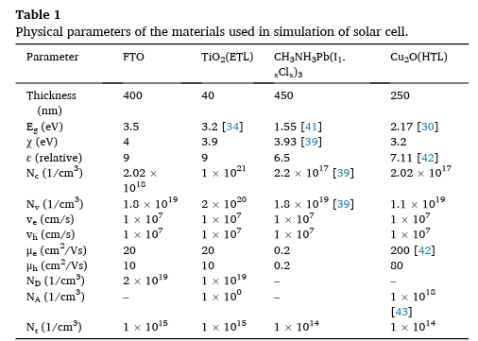
Simulation in SCAPS 1D-Parameters

Slide 36
The effective density of states is like counting how many steps are there in a particular energy range.
Nc-Effective DOS in Conduction Band
Nv-Effective DOS in Valance Band

Slide 37
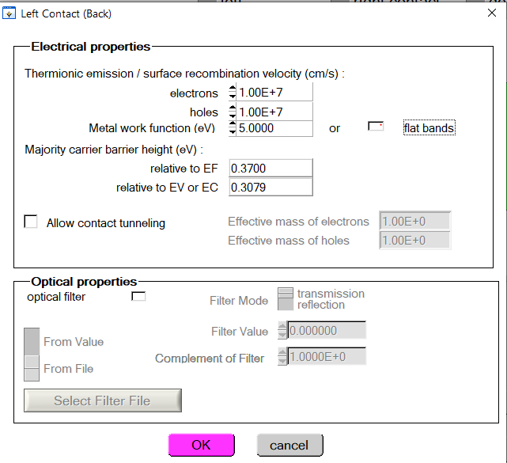
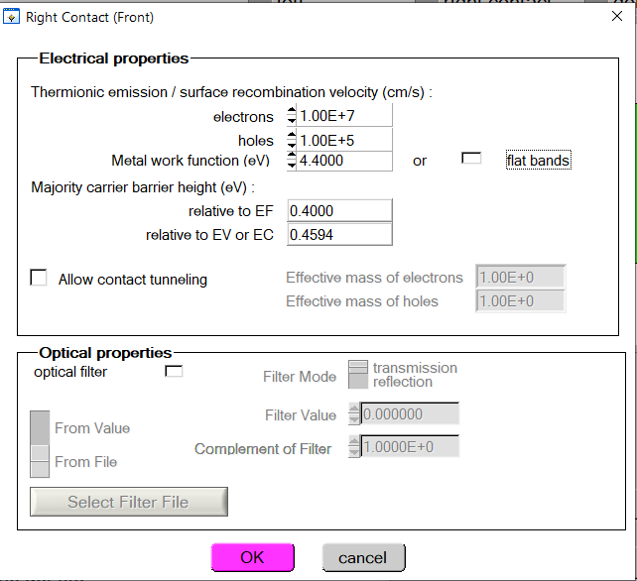
Simulation in SCAPS 1D

Slide 38
Dielectric Fiber Arrays
Dielectric Fiber arrays creates Microlens Effect
Microlenses made from dielectric fiber arrays are small, tiny lenses created using clusters of dielectric fibers.
These fibers are special materials that don't conduct electricity and can control how light travels.
When grouped together, they form small lenses that can help focus or shape light in specific ways.

Slide 39
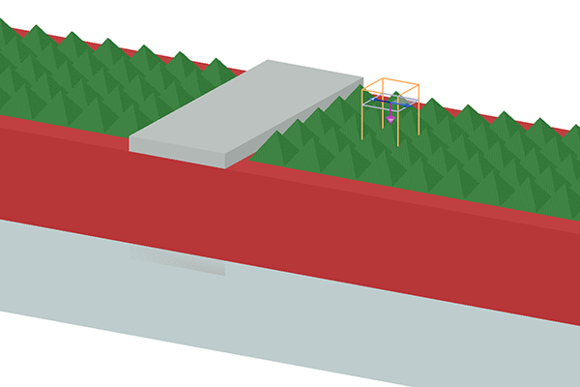
Can We incorporate Texture or Nanoparticles in ANSYS LUMERICAL?
“Lumerical’s simulators can predict the performance of new solar cell geometries which incorporate nanophotonic elements like metallic nanoparticles with plasmon resonances tuned to efficiently scatter the light into the absorbing layer, or nanotextured surface anti-reflection coatings to reduce undesirable back reflections that degrade cell performance.”
Tools: FDTD | CHARGE | STACK
FDTD (Finite-Difference Time-Domain)
https://www.lumerical.com/solutions/solar-cells/#:~:text=Lumerical's%20simulators%20can%20predict%20the,coatings%20to%20reduce%20undesirable%20back

Slide 40
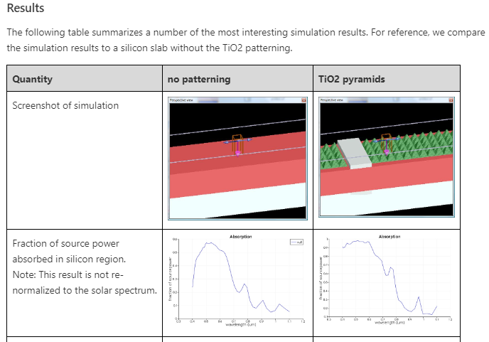
Can We incorporate Texture or Nanoparticles in ANSYS LUMERICAL?

Slide 41
Choice of Mixed Halide Perovskite
Mixed halide perovskite was chosen due to stability differences in intrinsic MAPbX3 (X = Cl, Br, I) compounds.
MAPbI3 exhibited low stability, while MAPbCl3 showed high stability, prompting the use of mixed halide perovskites.
CH3NH3Pb(I1-xClx)3 Selection
CH3NH3Pb(I1-xClx)3, a mixed halide perovskite, was selected as the absorber layer.
Partial substitution of I with Cl improved thermal stability, film quality, and diffusion length.

Slide 42
Title : Enhanced Light Harvesting in Perovskite Solar Cells by a Bioinspired Nanostructured Back Electrode.
Cell Used : ITO/PEDOT:PSS/ CH3NH3PbI3−xClx/PCBM/Bphen/Ag
Confinement Methods : incorporated bioinspired moth-eye nanostructures into the metal back electrode via soft nano imprint lithography
To evaluate the effect of the moth-eye nanostructured metal back electrode on light harvesting of PeSCs, three device architectures were constructed for comparison, including the metal (i) back electrode with a flat structure (ii) with a grating structure (iii) moth-eye nanostructure
Notes:
PEDOT:PSS is selected as a HTL PCBM layer has dual roles of an ETL and a passivation layer for reducing the charge traps in annealed perovskite films Bphen layer functions as an exciton-blocking layer (EBL)

Slide 43
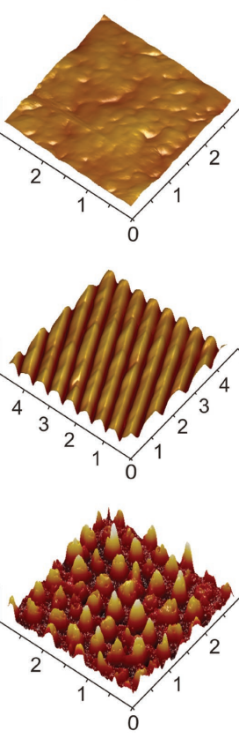
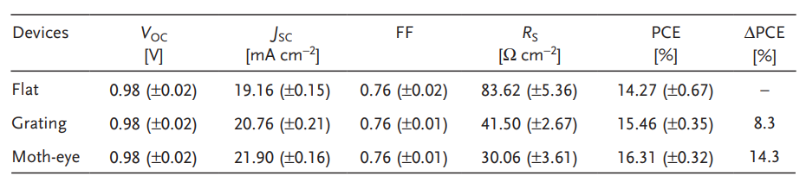

Slide 44
Literature Review
Title : Plasmonic Light Trapping in Thin-film Silicon Solar Cells with Improved Self-Assembled Silver Nanoparticles
Cell : glass/Ag (100 nm)/ AZO (60 nm)/Ag NPs/AZO (30 nm)/n-a Si:H / i-a Si:H/ p-a SiC:H
Confinement Method : plasmonic BR with random arrays of Ag NPs Randomly textured
Notes:
n-a Si:H: n-type hydrogenated amorphous silicon. This layer is doped with specific impurities to introduce extra electrons (n-type) as majority carriers. i-a Si:H: intrinsic hydrogenated amorphous silicon. This layer is undoped, meaning it has an equal number of electrons and holes (intrinsic), and it serves as the light-absorbing layer. p-a SiC:H: p-type hydrogenated amorphous silicon carbide. This layer is doped with different impurities to introduce extra holes (p-type) as majority carriers.

Slide 45
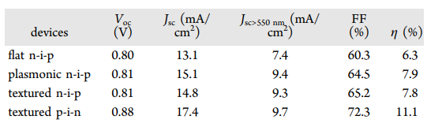
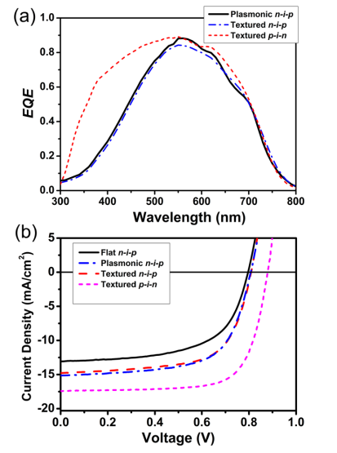

Slide 46
Literature Review
Title : A modified architecture of a perovskite solar cell with an enhanced optical absorption in the visible spectrum
Cell : ITO/TiO2/Perovskite/CuSCN/Back Contact
Confinement Method : nanostructured PSC with a plasmonic enhancement
Notes:
In the planar structure studied in this paper, CH3NH3PbI3 perovskite applied as the light absorbent layer, copper (I) thiocyanate (CuSCN) as HTL, titanium dioxide (TiO2) as ETL, and indium thin oxide (ITO) and gold (Au) as the upper and lower electrodes, respectively

Slide 47
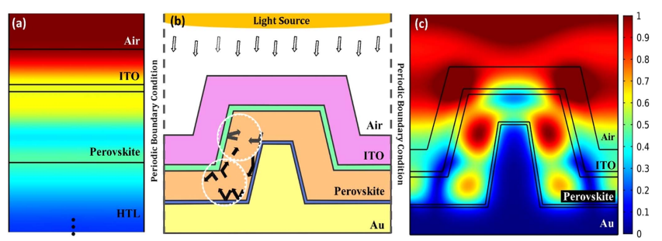
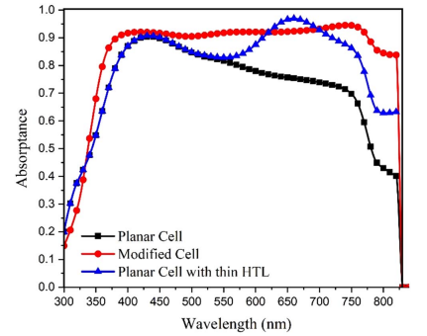
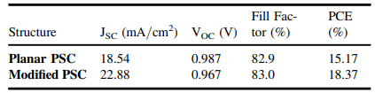

Slide 48
Literature Review
Title : OPTICAL CONFINEMENT IN CHALCOPYRITE BASED SOLAR CELLS
Cell : ZnO:Al(400 nm)/ZnO(50 nm)/CdS(40 nm)/CIGS(dCIGS)/interfacial layer(15 nm)/Mo/glass
Confinement Method :
Technique 01 : Photocurrent Boosting
Minimising optical losses
Supporting front layers by using novel low-absorbing materials, starting from the front transparent conductive oxide (TCO) contact [2–4], introducing alternative window layers [5,6],
B. optical back reflectors with local contacting
C. Anti-reflecting structures at front interfaces
D. investigating nanotextures [7,13] and metal and dielectric nanoparticles [9,14,15] for light scattering.
Technique 02: Light Trapping
1. Anti-reflection at front interfaces,
2. High reflection at back contact (ZrN)
Introduction of a highly reflective
Highly diffusive back reflector
3. Light scattering
4. Optical Path Enhancement
Technique 03 : Light management structure
Semi-ellipsoidal texture (by non-conformal layer growth) was introduced to the substrate (abosorber) of the ultra-thin device. (Done by Comsol Multiphysics (version 5.2, Wave optics module),technique "FEM").
Notes:
In the planar structure studied in this paper, CH3NH3PbI3 perovskite applied as the light absorbent layer, copper (I) thiocyanate (CuSCN) as HTL, titanium dioxide (TiO2) as ETL, and indium thin oxide (ITO) and gold (Au) as the upper and lower electrodes, respectively

Slide 49
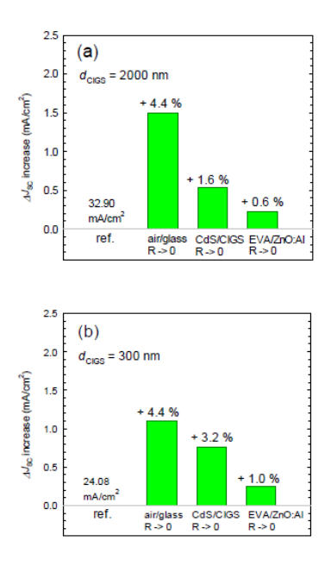
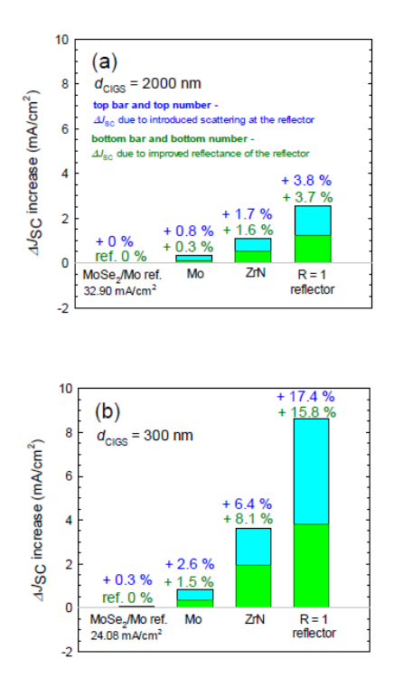
In ultra-thin Cu(In,Ga)Se2 devices highly reflective back contact is inevitable
Light scattering can double the short-circuit current gain in ultra-thin devices.
Rigorous optical simulations revealed potential for > 22 % gain in ultra-thin device.

Slide 50
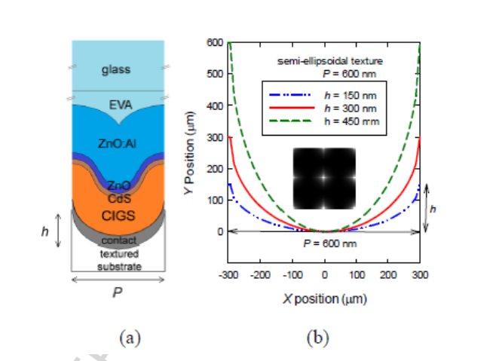
Semi Ellipsoidal Texture

